Slide 2
The Essential Recipe:
Basic Ingredients of a Risk Management and Safety Plan
Speakers:
Jeffrey Petrunak of National Interstate Insurance
Daniel Tomlinson of Lancer Insurance
AV Sponsor
Coffee Sponsor

Slide 3
Welcome & Thank You to Our Sponsors
AV Sponsor
Coffee Sponsors

Slide 4
Policies and Procedures
Get Organized
What policies do you have in place and where are they?
Is everyone utilizing the same policies?
e.g., same manuals, versions, etc.
Do you have conflicting policies?
Have you read your policies?
Are they company specific and meet operational profile/needs?
AV Sponsor

Slide 5
Best Practices When Hiring
Where do you recruit new drivers?
Job boards, websites, word of mouth
Thorough and Proper Interview
Find out as much information as you can
Stay away from unacceptable questions like protected classes, age discrimination, bias
Thorough Background Checks
Previous employers, criminal checks, PSP https://www.psp.fmcsa.dot.gov/psp/home
Drug and Alcohol Testing
Company Drug and Alcohol Policy
Separate pools for DOT/Non-DOT
Valid Licensing and Certifications
Clear Employment Agreements
AV Sponsor

Slide 6
Driver & Employee Files Best Practices
Get Organized
Create a driver/employee file system (recommend having a driver qualification file, personnel file & training file)
Recommend fastener file folders and/or electronic files & checklists
Driver Qualification Files
Qualification-related documents
Manage critical expirations
Personnel Files
HR documents
Training Files
Training documentation
DQF Checklist
Original Documents
DQF Checklist
Recurring Documents
AV Sponsor

Slide 7
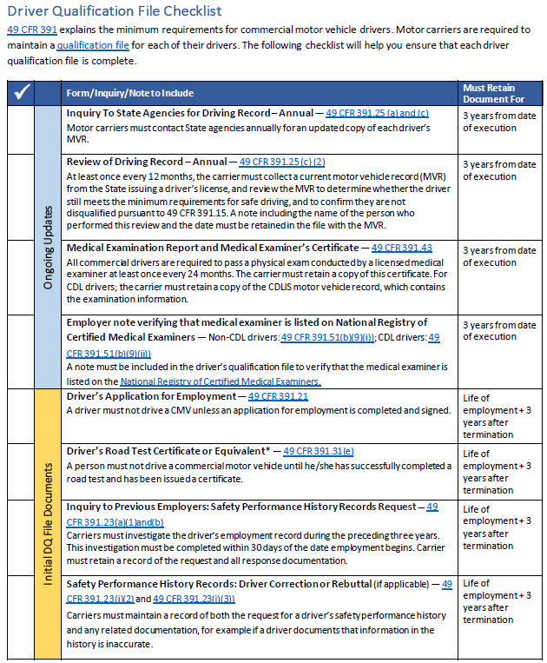
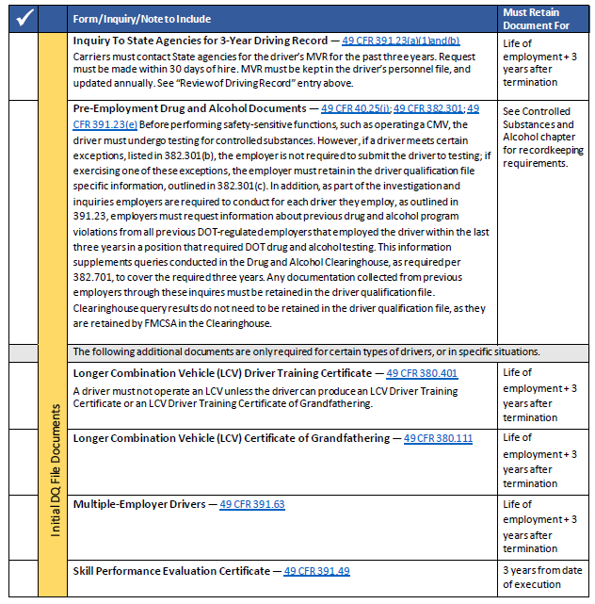
AV Sponsor

Slide 8
Driver and Vehicle Management
Regular Driver Training/ Safety Meetings
Classroom/Road
Document topics and attendance
Defensive Driving Courses
Online, On-site
Documentation
Safe/Regular Vehicle Maintenance
Communications Protocols
Cell phone policies
Performance Monitoring
Cameras, Customer Feedback, Claims
Crisis Management Plan
Should have something in place
Tailored to your operation
Updated regularly
AV Sponsor

Slide 9
File Management Best Practices
Get Organized
Accident Files
One file per incident
Accident reports, police reports, photographs, video footage, preventability, etc.
Drug and Alcohol Files (Random Testing)
Year per testing quarter/period
List of covered employees in pool, list of randomly selected employees, CCF’s results
Vehicle Maintenance Files
Formal preventative maintenance program & a systematic tracking system
Individual vehicle maintenance files and a process for reporting/repairing deficiencies
Vehicle service records: repairs, inspections, DVIRs, etc.
AV Sponsor

Slide 10
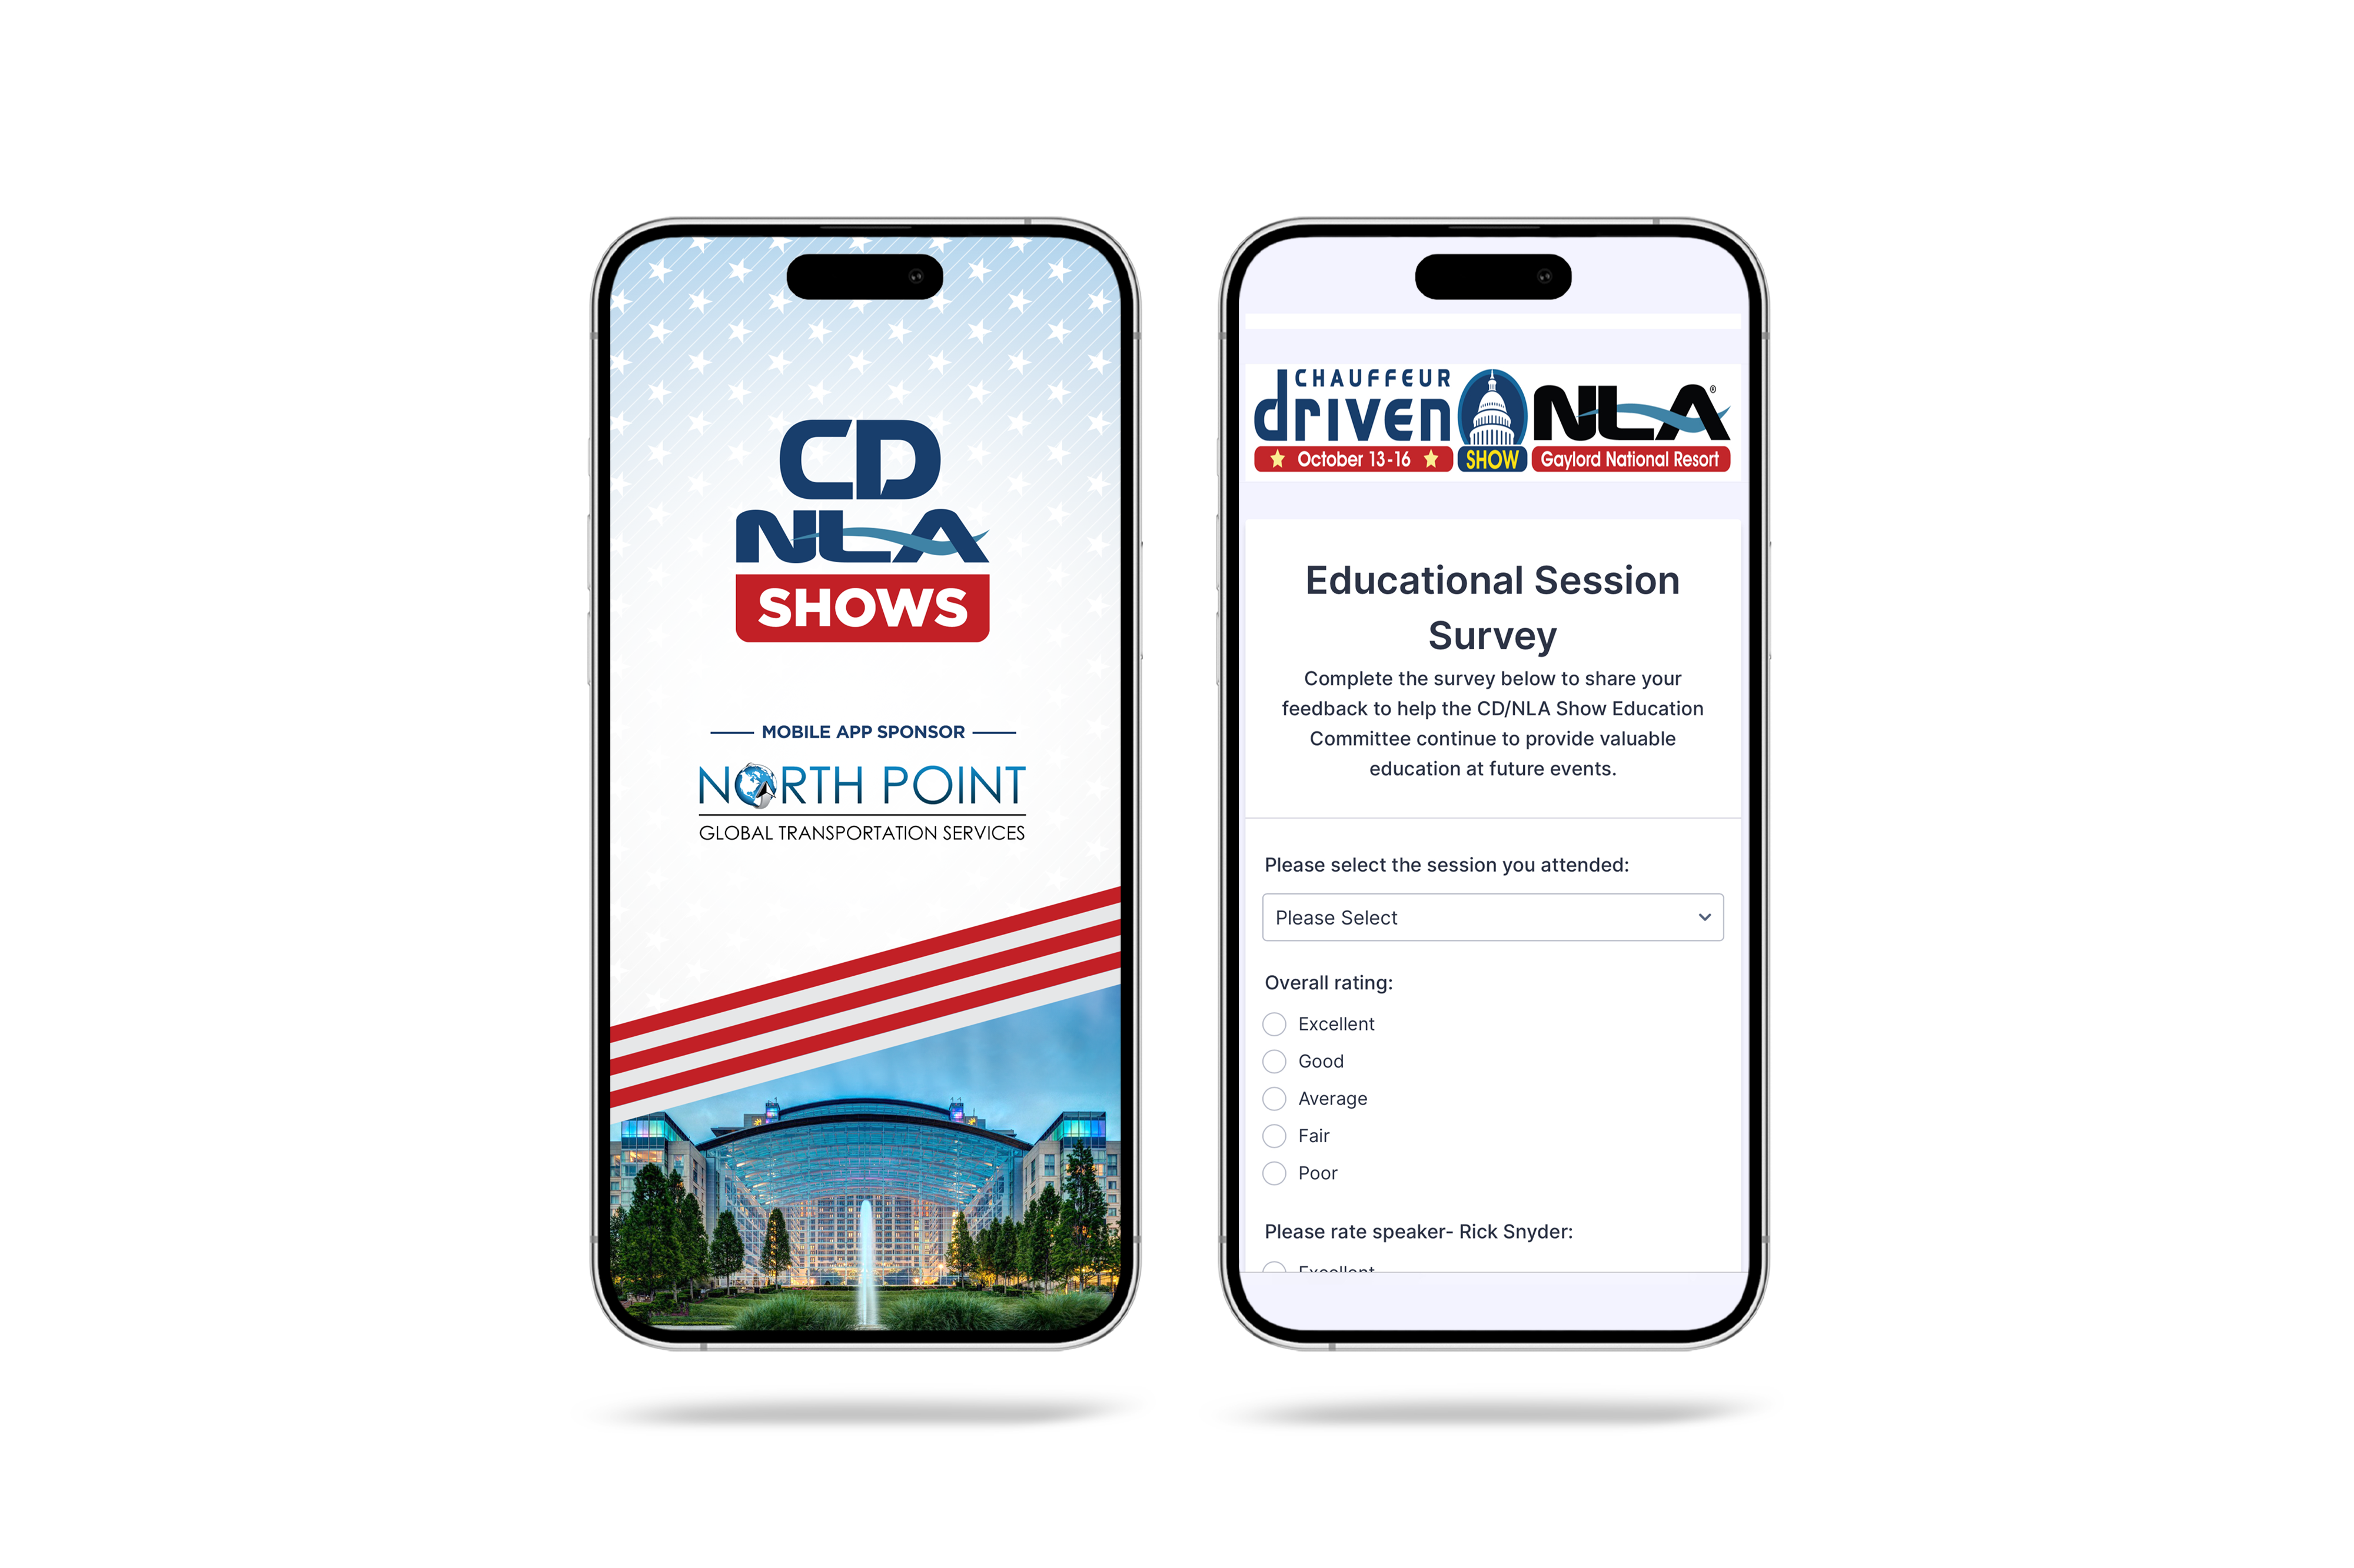
Let Us Know How
We Did!
Fill Out the Survey
AV Sponsor
Coffee Sponsor

Slide 11
Thank You for Joining Us!
AV Sponsor
Coffee Sponsor

